Slide 1


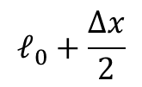
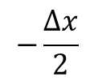

$$−\frac{Δx}{2}$$
$$ℓ_{0}+\frac{Δx}{2}$$
$$\hat{x}$$
$$0$$
$$ℓ_{0}$$
e⁻
neutral plasma
ion

Slide 2



$$ℓ$$
$$\hat{x}$$
$$ℓ_{0}$$
m₂
m₁

